Slide 1
The Battle of Neighborhood of Kavala, Greece
Symela Micha
January 2020

Slide 2
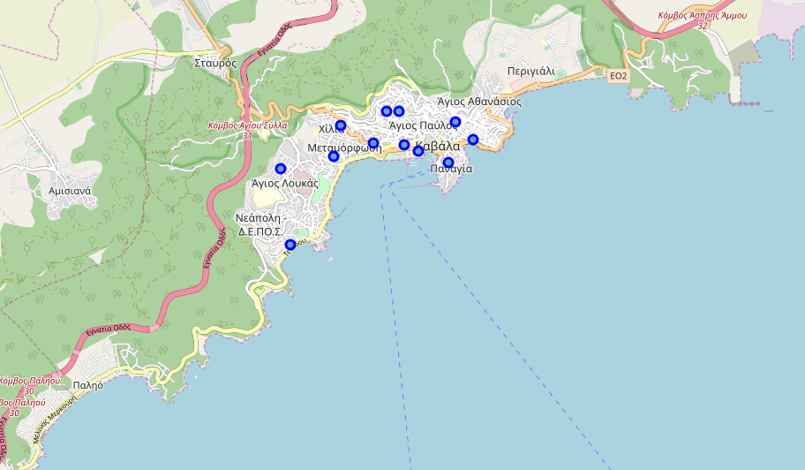
Agenda
Introduction
Data
Methodology & Tools
Results
Conclusion

Slide 3
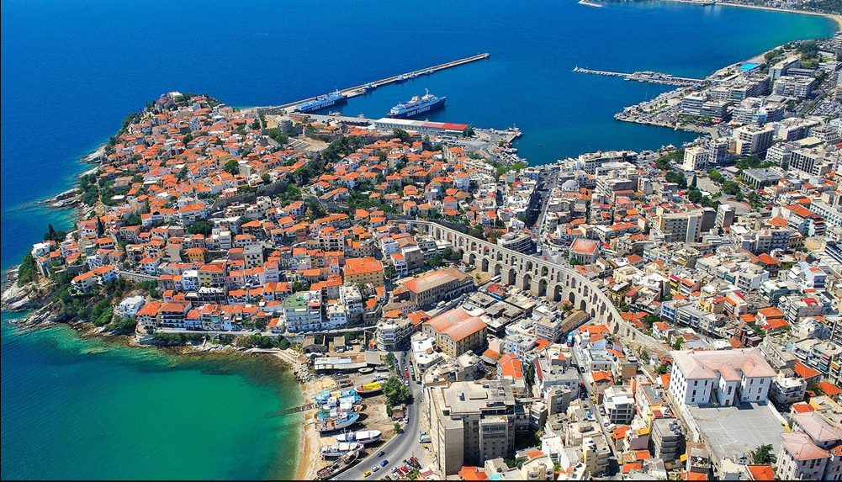



Introduction
This project is to take a glimpse at different neighborhoods of Kavala, Greece.
This project may be interesting for property developers to develop new shops in my hometown.
Such activity will increase the number of yearly visitors and of course the GDP of Kavala

Slide 4
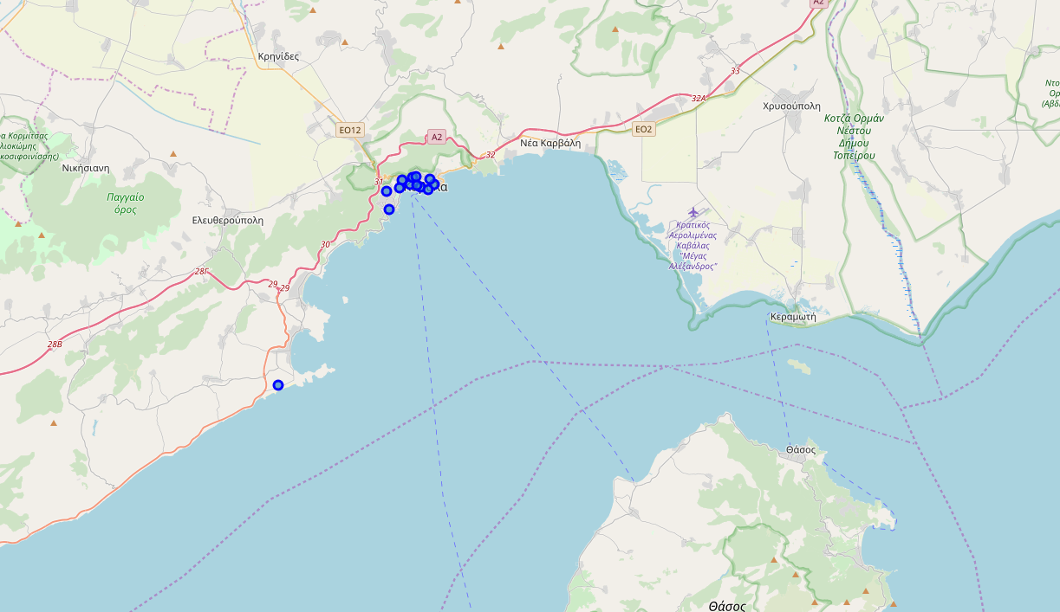
Data
Identified some neighborhoods and collected on their coordinates, latitude and longitude, of Kavala city from online sources.
Example of neighborhoods
 | Neighborhood | Latitude | Longitude
0 | Agia Varvara | 40.937605 | 24.419196
1 | Agios Athanasios | 40.817017 | 24.295531
2 | Agios Ioannis | 40.937147 | 24.399825
3 | Agios Loukas | 40.933324 | 24.381728
4 | Dexameni | 40.939726 | 24.393477

Slide 5
Methodology & Tools
Skills from all previous weeks lab activities plus some Python programming skills and knowledge of IBM cloud to help the project.
The notebook will be created in IBM Watson Studio.
GitHub will be used to share the notebook and commit it to the Master branch.
We relied on the Foursquare API to retrieve all venues of each identified neighborhood of Kavala city.
Then we grouped each neighborhood and count how many venues exist. Then filter them on the top 100 which are within a radius of 2000 meters.
As a final step we analyzed each neighborhood and selected “Bougatsa shop” as the suggested shop to be developed. Bougatsa shops are bakeries with traditional North Greece soured pie. Such investment is very important for the locals and it is an attraction of tourists too.

Slide 6
Results
Most of the Bougatsa shops are concentrated in the central area of Kavala city, with the highest number in cluster 2 and moderate numbers in cluster 0. See below tables:
 | Neighborhood | Bougatsa Shop | Cluster Labels | Latitude | Longitude
0 | Agia Varvara | 0.030303 | 2 | 40.937605 | 24.419196
2 | Agios Ioannis | 0.030000 | 2 | 40.937147 | 24.399825
6 | Kentro (Centre) | 0.031915 | 2 | 40.935979 | 24.408504
7 | Panagia | 0.032258 | 2 | 40.934301 | 24.414428
8 | Perigiali | 0.031250 | 2 | 40.936883 | 24.405780
9 | Potamoudia | 0.030928 | 2 | 40.941755 | 24.402274
10 | Profitis Ilias | 0.031579 | 2 | 40.941833 | 24.404720
11 | Timios Stavros | 0.030000 | 2 | 40.940257 | 24.415810
 | Neighborhood | Bougatsa Shop | Cluster Labels | Latitude | Longitude
4 | Dexameni | 0.02 | 0 | 40.939726 | 24.393477
12 | Vyronas | 0.02 | 0 | 40.935112 | 24.391967

Slide 7
Results
On the other hand, cluster 1 has very low numbers to totally none bougatsa shops in the neighborhoods. This represents a great opportunity and high potential areas to open bougatsa shops as there is very little to none competition from existing shops. See below table:
 | Neighborhood | Bougatsa Shop | Cluster Labels | Latitude | Longitude
1 | Agios Athanasios | 0.0 | 1 | 40.817017 | 24.295531
3 | Agios Loukas | 0.0 | 1 | 40.933324 | 24.381728
5 | Kalamitsa | 0.0 | 1 | 40.922226 | 24.383695

Slide 8
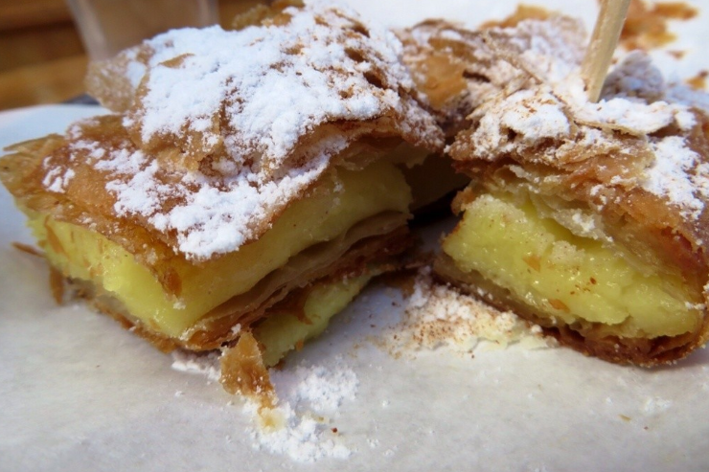
Conclusion
Kavala city is a nice city to invest in properties as it combines 2 different landscapes: mountain and sea.
When an investment is related with tradition is for sure a touristic attraction.
Bougatsa ->

Slide 9
Thank you!

